Slide 1
Primer on Image Processing and Analysis
Jimmy Giedt and Albert Lee
Insight Data Science

Slide 2
What is an image?
2-D Array of Pixels, where values are pixel intensity
Grayscale Images
- Pixels are scalars
- Can be 8 bit (0…255) or more
Color Images
- Pixels are vectors
- Vector is some order of RGB

Slide 3
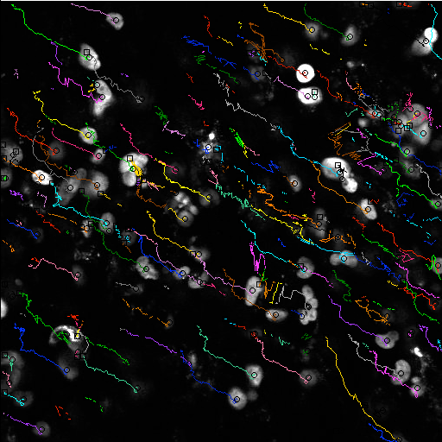
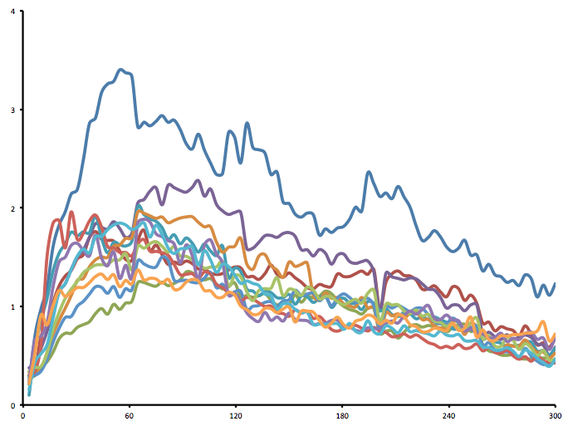
General Image processing
Image processing is the analysis and manipulation of images to improve their quality
Image analysis is the extraction of useful data from (primarily) digital images.
Examples of image processing include:
Finding the edges of an object
Counting similar objects
Calculating the area/ perimeter/ length of objects
Finding the intensity of objects found in an image
Labeling and tracking objects over the course of a longitudinal image sequence
A
B
2
Drug Concentration (uM)
1
0
0
1
2
3
Time (hrs)

Slide 4
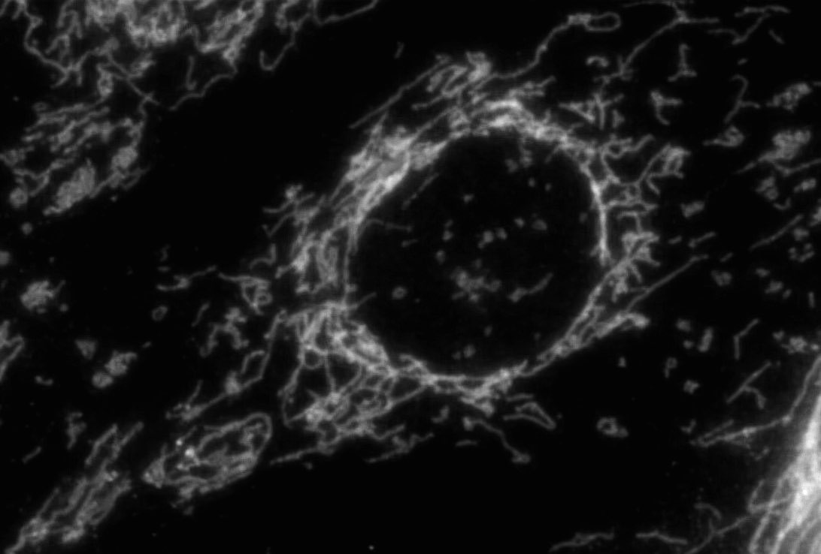
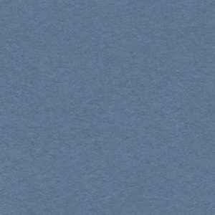
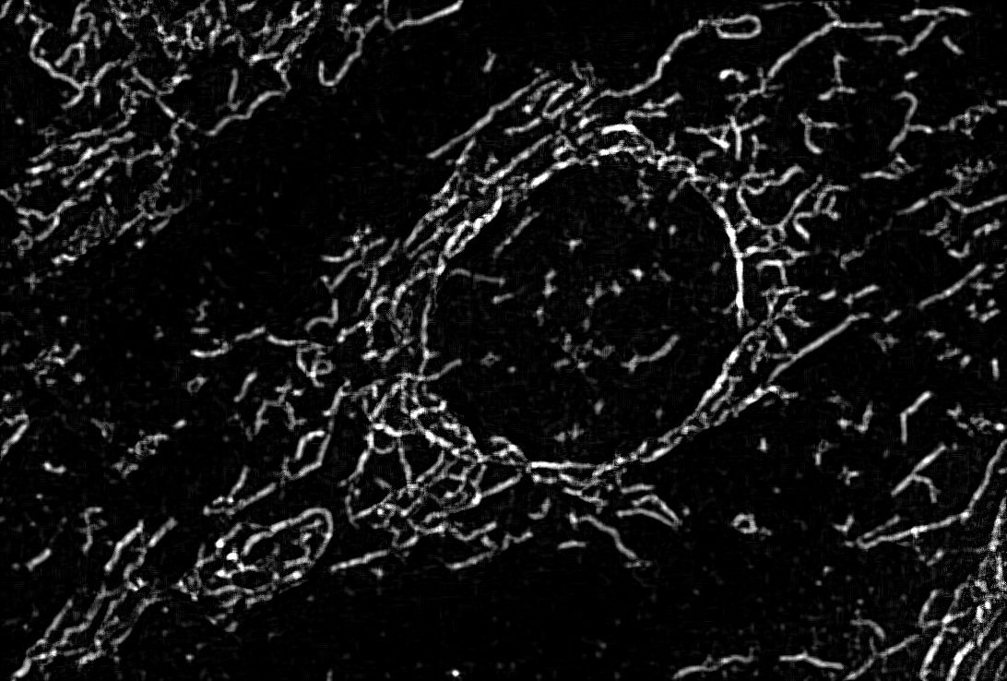
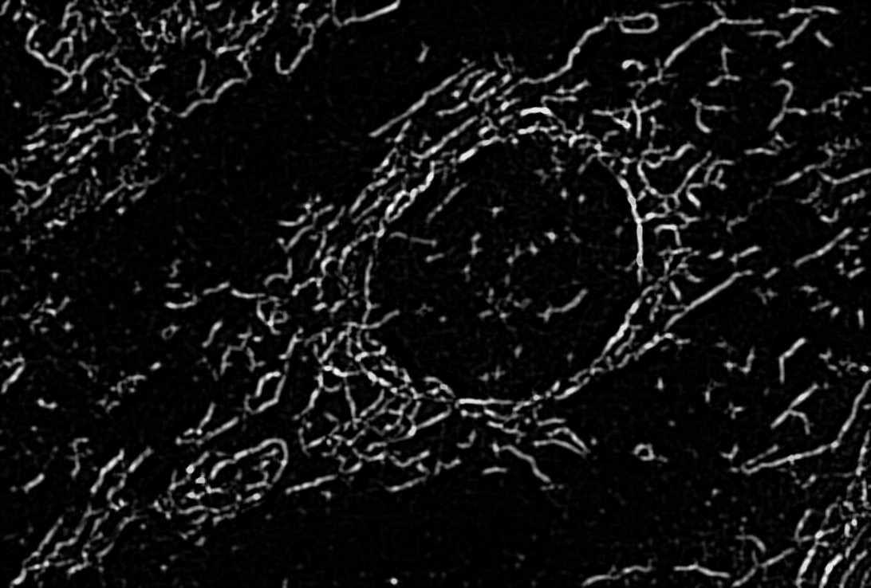
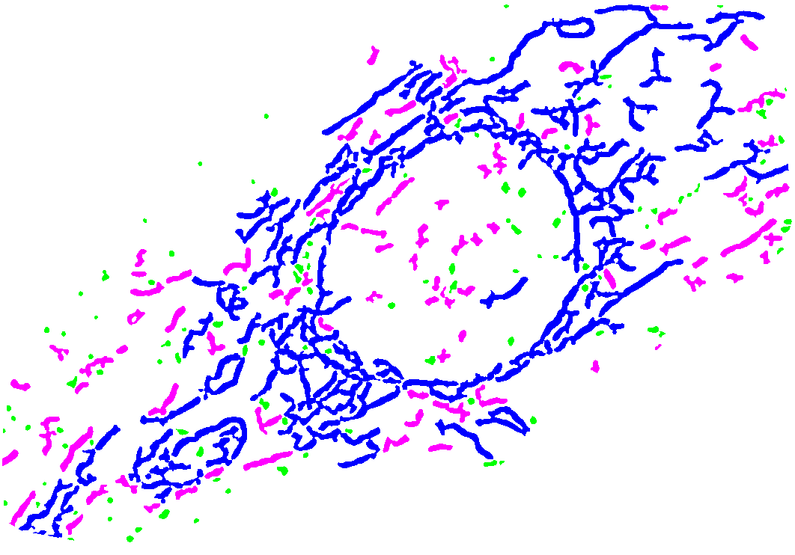
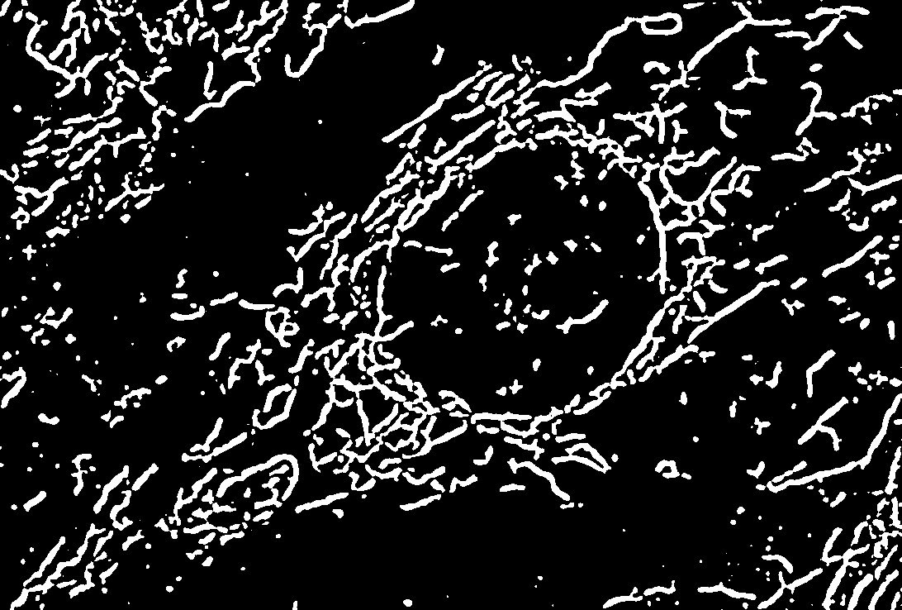
Image processing and analysis
A typical approach to image analysis is:
1. Separate color images into constitutive RGB components.
2. Filter images (huge variety of methods and tricks based on image qualities).
3. Separate foreground from background by some method.
4. Acquire desired data.
Image
Background Subtraction
Filter
Thresholding

Slide 5
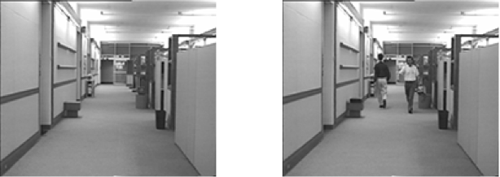
Separating foreground from background
Variety of methods for doing so:
- Free/ Hand Selection
- Edge Detection
- Thresholding
- Color based selection
- Movement based selection/ Temporal averaging

Slide 6
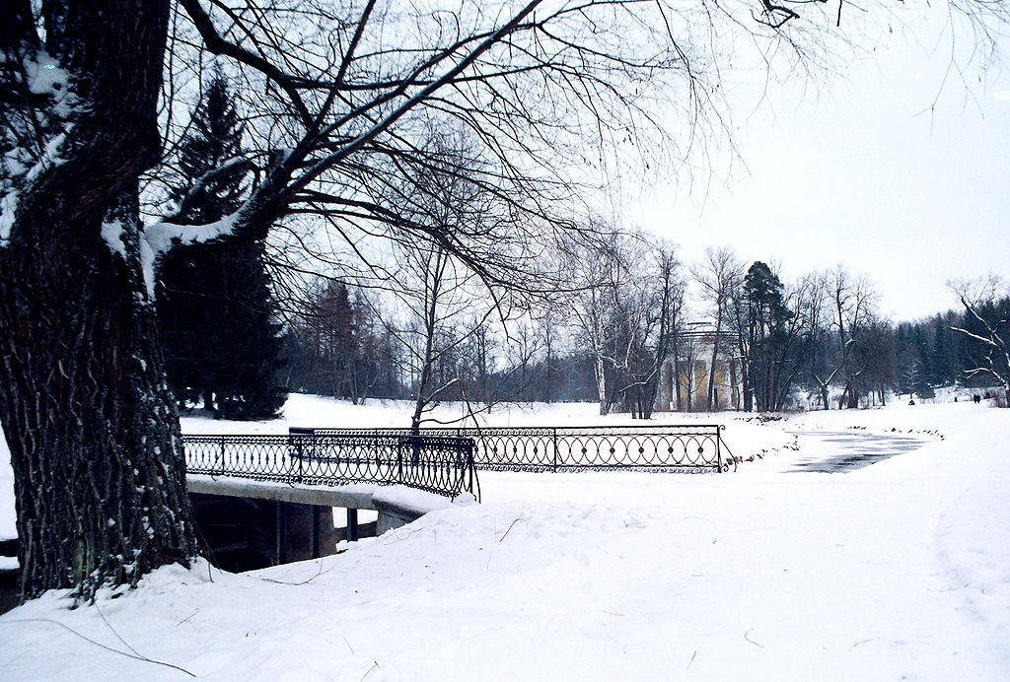
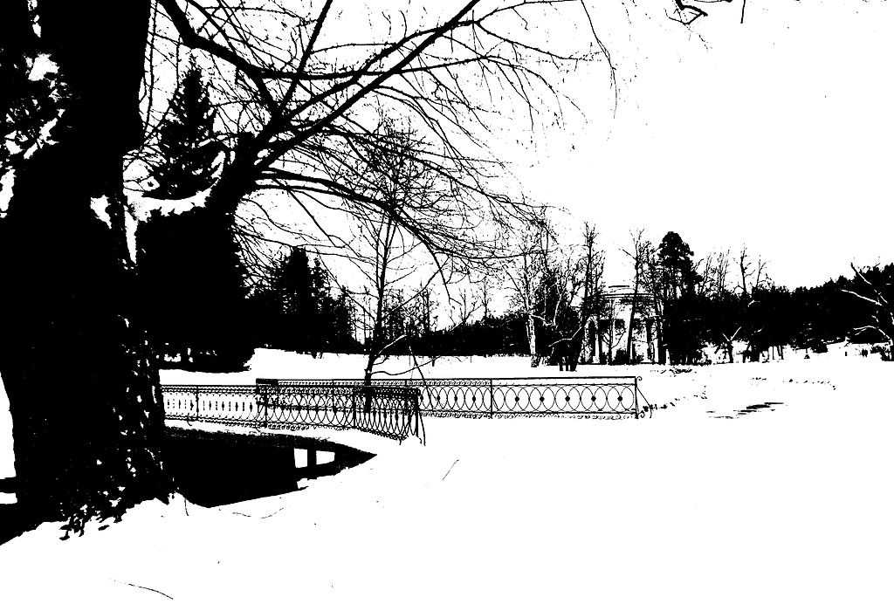
Thresholding Images
Thresholding is the simplest method of image segmentation. It is typically used to transform grayscale image (image with 0-255 intensities) to a binary image (intensity is either 0 or 1).
Multiple Types of Thresholding available:
Histogram shape: based on the peaks and valleys of a smoothed histogram.
Clustering-based: gray-level samples are clustered in two parts as background and foreground (object)/ modeled as mixture of two gaussians.
Entropy-based: algorithms use entropy of the foreground background regions.
Object Attribute: search a measure of similarity between the gray-level and the banalized images, such as fuzzy shape similarity, edge coincidence etc.
Spatial methods: use higher-order probability distribution or correlation between pixels
Local Methods: adapt the threshold value on each pixel according to the local image characteristics.

Slide 7
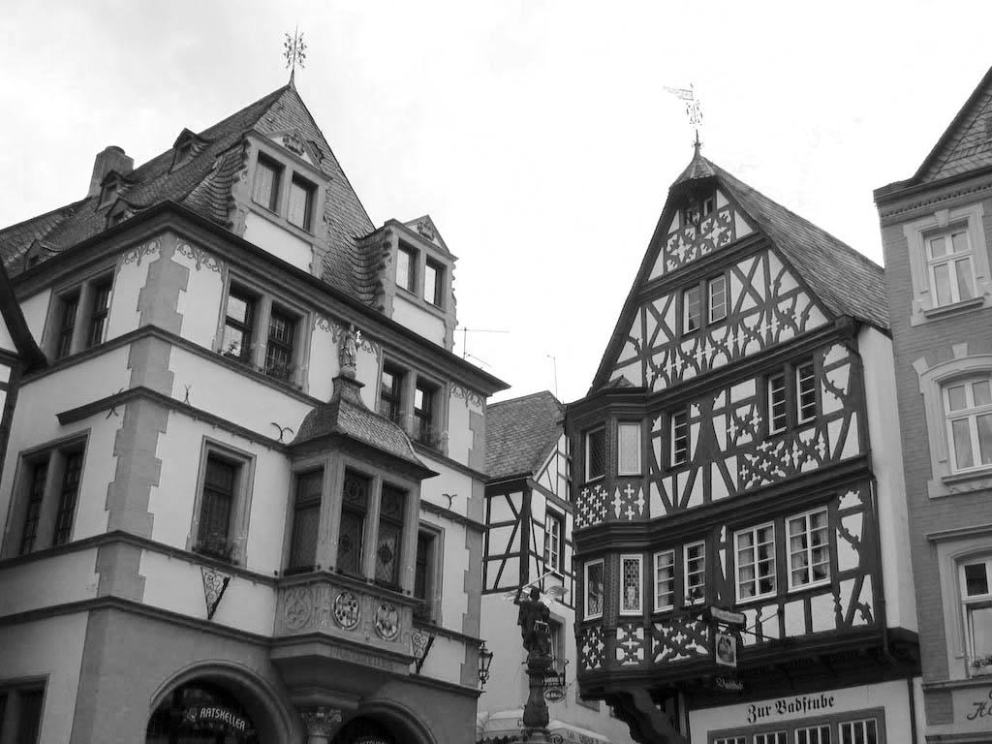
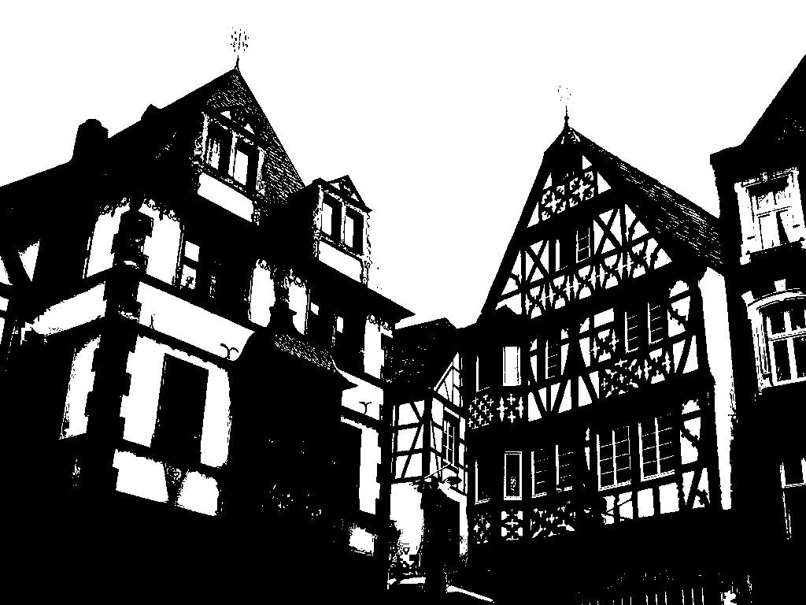
Example - Otsu’s method
Otsu’s method is one of the first techniques for automatically segmenting images.
The method assumes that images are made up of two classes, foreground, and background.
The technique first finds the histogram of an image, and then attempts to maximize the variance between two classes of pixels.

Slide 8
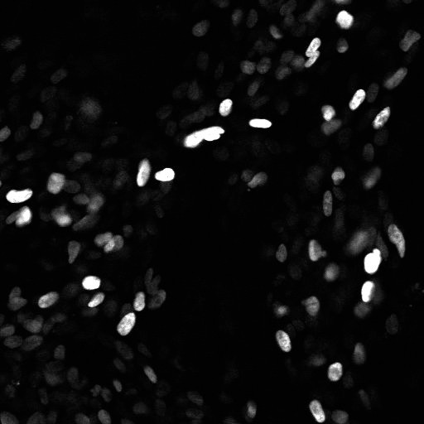
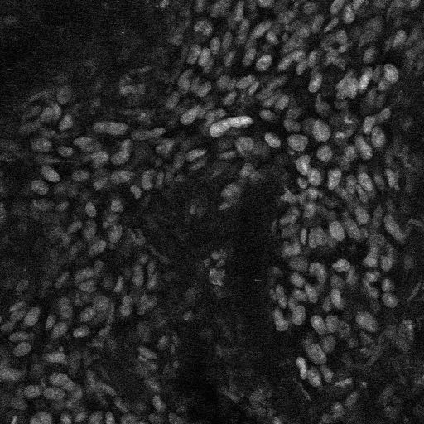
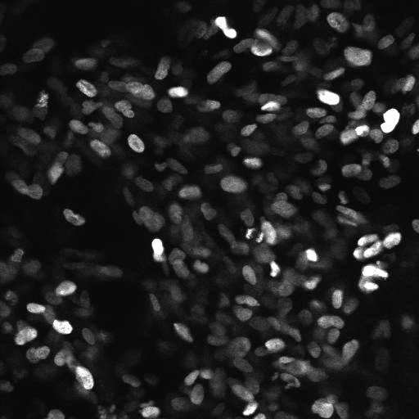
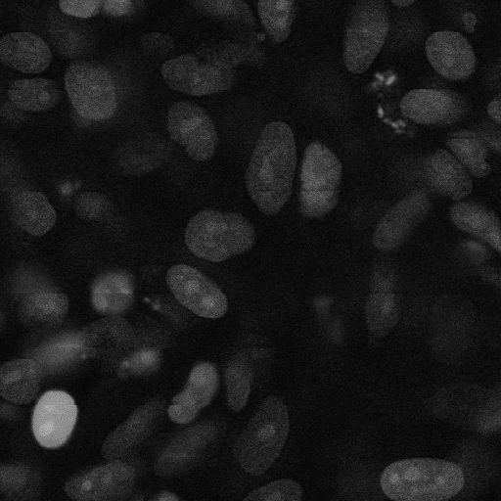
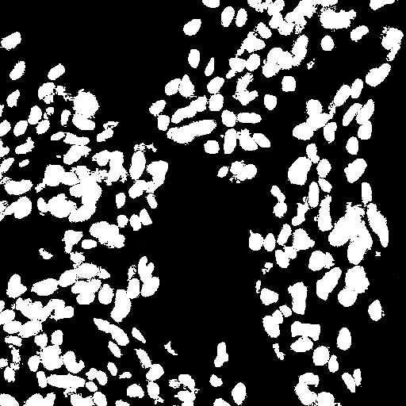
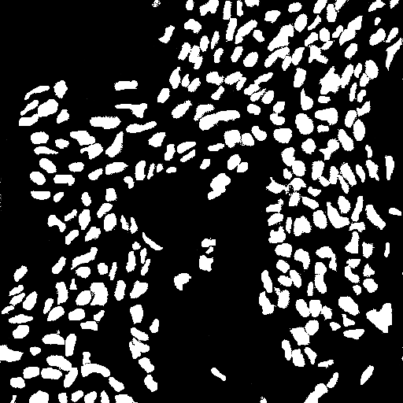
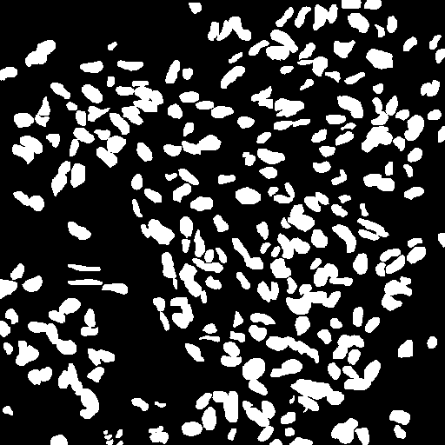
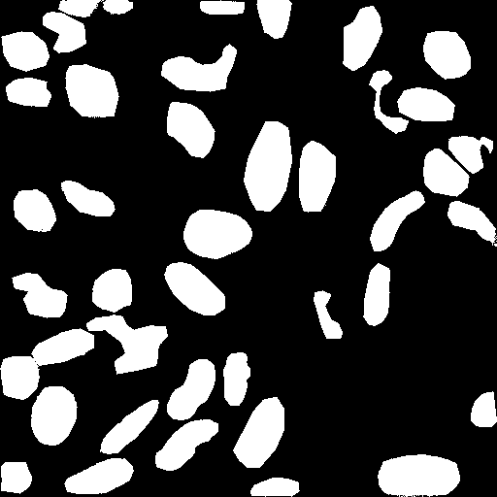
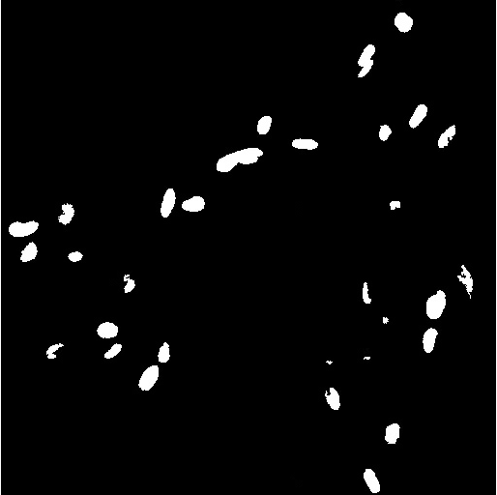
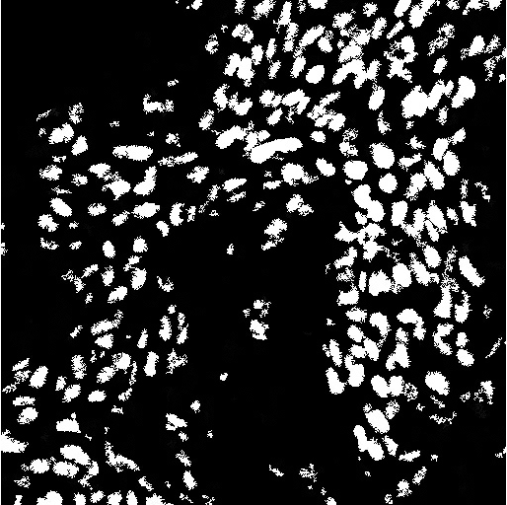
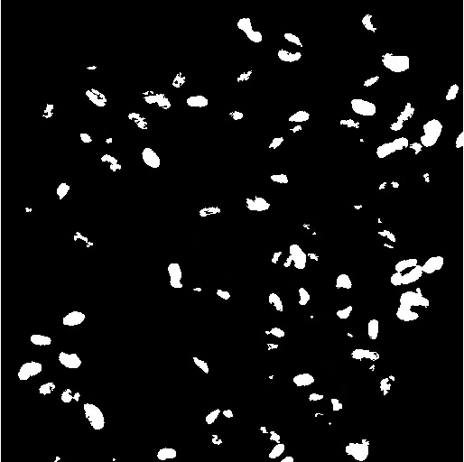
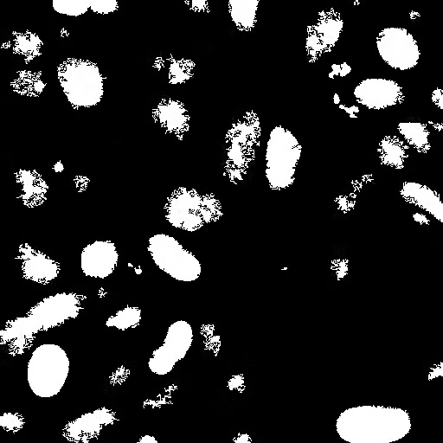
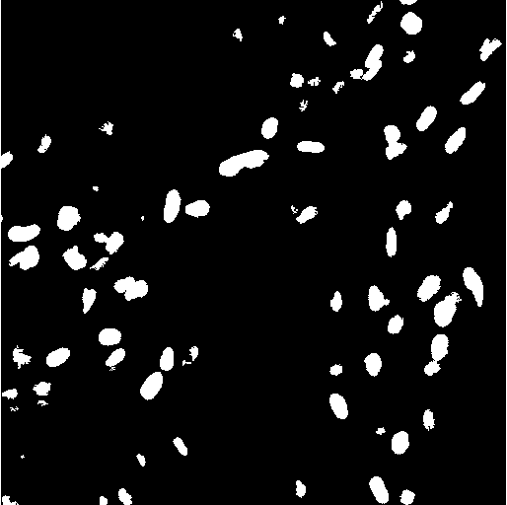
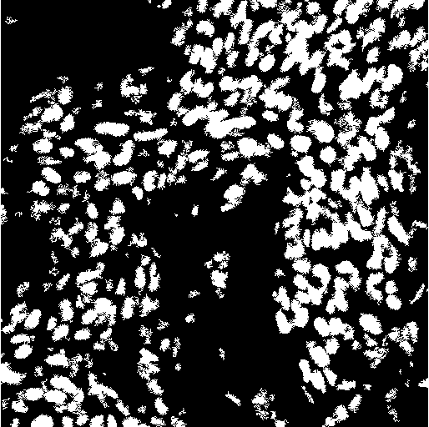
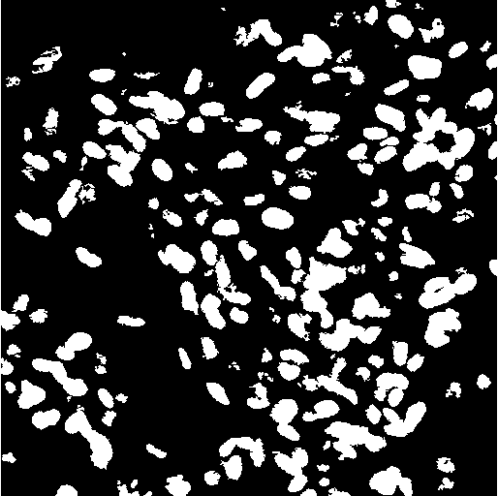
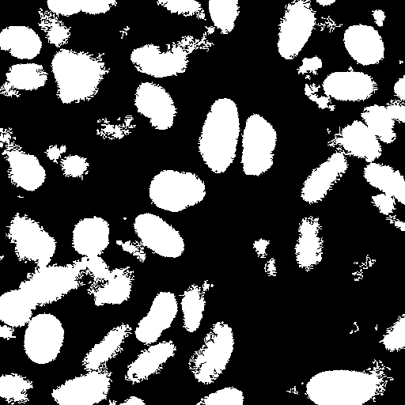
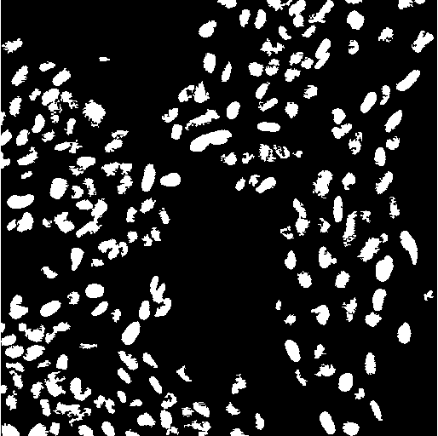
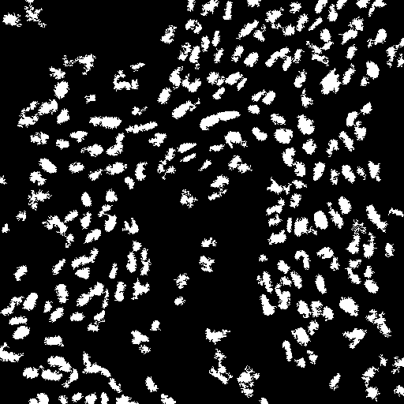
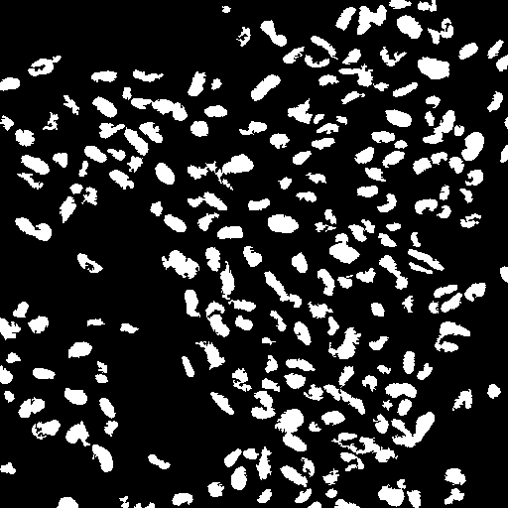
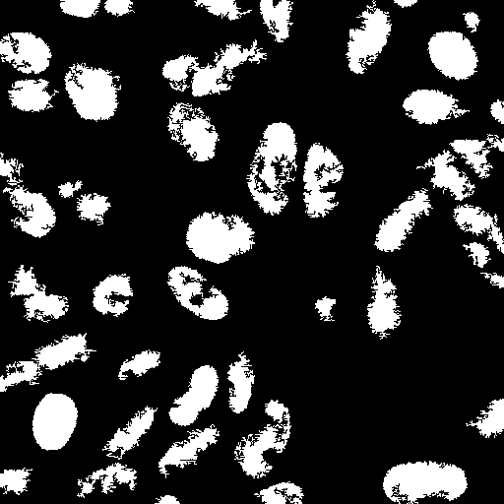
Thresholding Images
A
B
C
D
Original
Manual
Otsu
Huang
Ray

Slide 9
Separating foreground from background
Variety of other methods for doing so:
- Free/ Hand Selection
- Edge Detection
- Thresholding
- Color based selection
- Movement based selection/ Temporal averaging

Slide 10
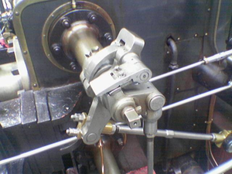
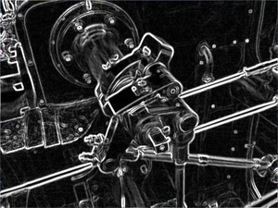
Sobel Edge Detection
- Edge methods are based on gradient changes in images.
- Variety of methods (Canny, Deriche, Differential, Prewire, Roberts, Tomasi etc.)

Slide 11
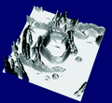
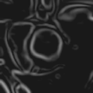
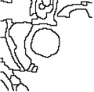
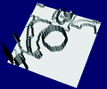
Watershed Method
- Method finds edges of objects by analyzing image gradients for local minimums. The same idea as watching water flow down hills/ geography to a basin.
- Often very helpful for separating connected cells in imaging applications.

Slide 12
After detecting foreground/ background?
- Easy to find properties of regions no matter what image processing method is utilized… bwlabel in matlab can find multiple descriptors of each labeled region for example.
- For microscopy, functions such as finding the size of objects or the intensity of pixels are generally helpful/ easily accessible.

Slide 13
How can I implement for my work?
- ImageJ/ FIJI… thresholding/ pixel intensity functions available. Can automate by recording macro.
- Matlab w/ image processing toolbox.
- Python with installed scikit-image, opencv, numPy, PIL, mahotas, scikit-learn and possibly others installed.

Slide 14
Resources to learn more?
Python Imaging Library Handbook
http://effbot.org/imagingbook/pil-index.htm
Digital Image Processing (3rd Edition)
https://www.amazon.com/Digital-Image-Processing-3rd-Edition/dp/013168728X
Programming Computer Vision with Python
http://programmingcomputervision.com/

